Slide 1

MANIPULATION OF A ROBOT ARM USING COMPUTER VISION AND MACHINE LEARNING ALGORITHMS
Giannakopoulou Lamprini
Moraiti Panagiota

Slide 2
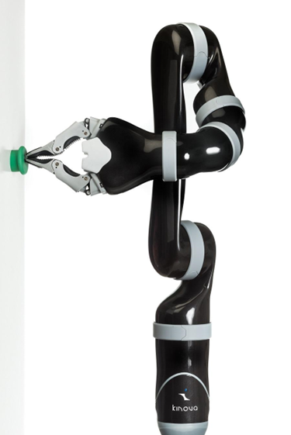
Kinova j2n6s200 robotic arm
6 D.O.F Robotic arm
Can be utilized in a variety of applications including providing assistance to individuals with disabilities, as well as automation tasks

Slide 3
Simple Pick And Place Procedure
Our first task
When pressing a button the arm picks up the cube from a location and places it in another
Both locations are predefined

Slide 4
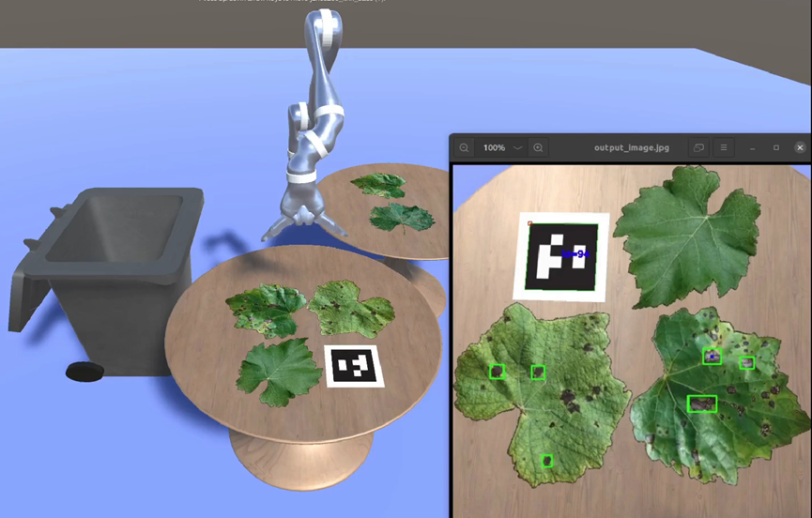
Detecting Leaves with Disease
Object detection model for recognizing the dark spots on the leaves (yolov4)
The robotic arm has a camera attached near its end effector
A raycast sensor is used for measuring the vertical distance from the detected leaves
An ArUco marker helps figure out the relative position of the object to the end effector

Slide 5
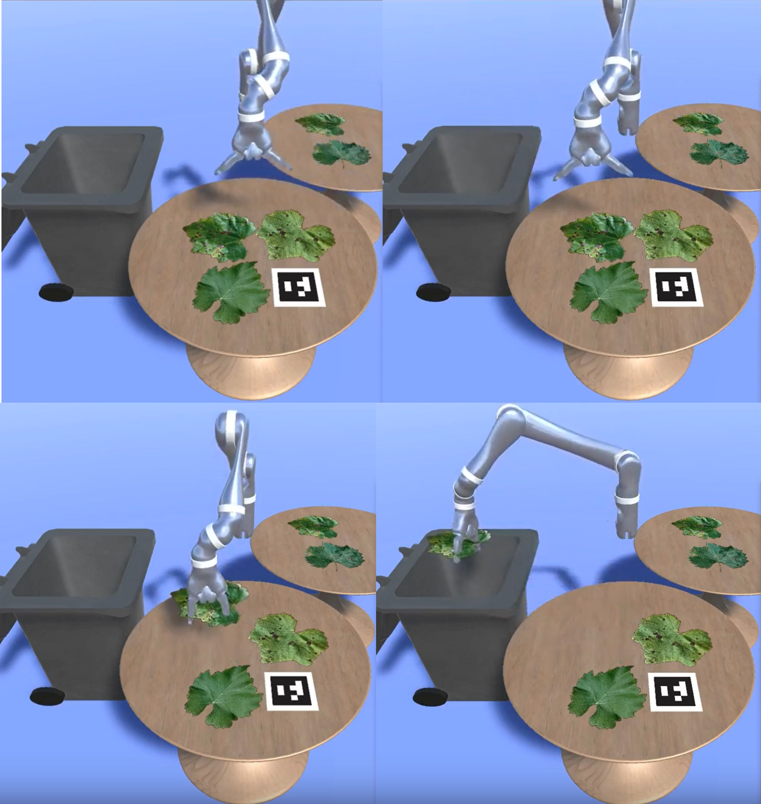
Detection and Grasping Pipeline
The end-effector places itself above the table and takes a picture of its surface
Using the machine learning model the position of the object is determined and the end-effector is positioned directly above the leaf
The vertical distance between the end-effector and the object is calculated using the raycast sensor
The hand decends and grasps the leaf
The leaf is placed inside the bin
If the model does not detect anything, the arm stays in “Photo-Position”, taking screenshots until an object is detected

Slide 6
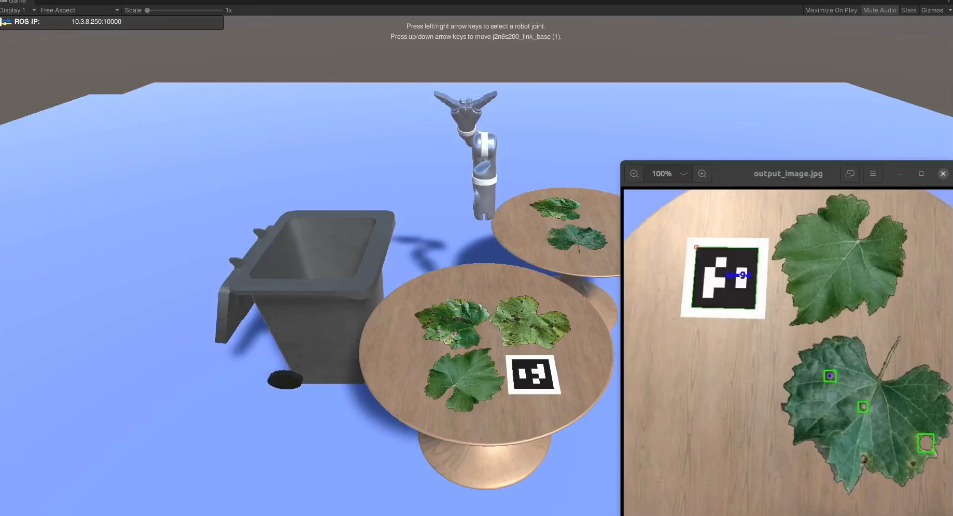
Possible Applications
The described system could find application in an automated setup for collecting diseased leaves.
Great potential for agricultural processes, enables the removal of diseased leaves and preventing the spread of diseases within the farm.

Slide 7
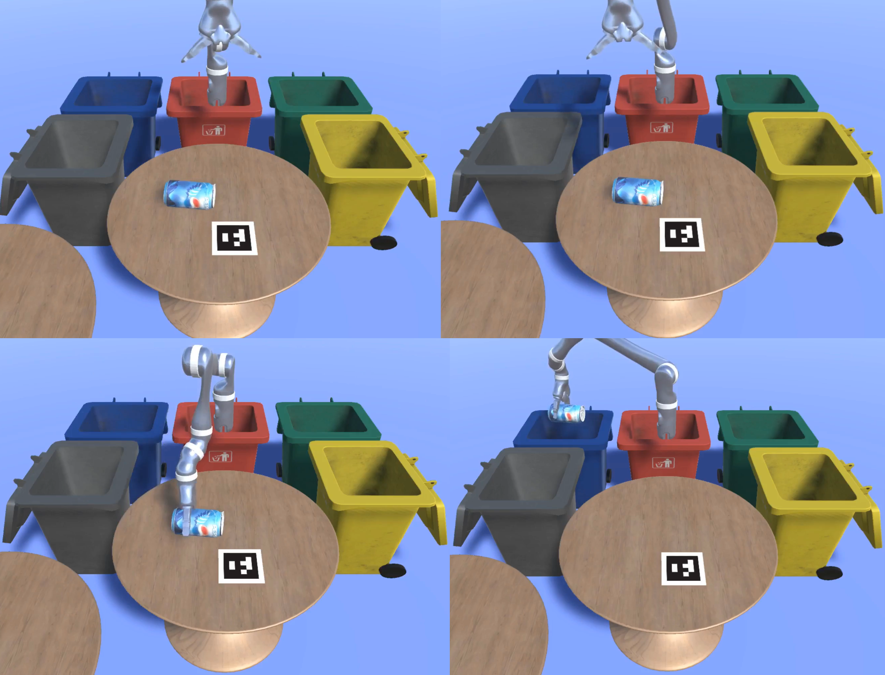
Garbage Sorting
Similar structure with leaves detection project
Object detection model for recognizing the dark spots on the leaves (SSD MobilenetV2)
Additionally, the model classifies the garbage into 5 categories (plastic, metal, glass, paper, other)
The detected objects are placed in the bins according to their material

Slide 8
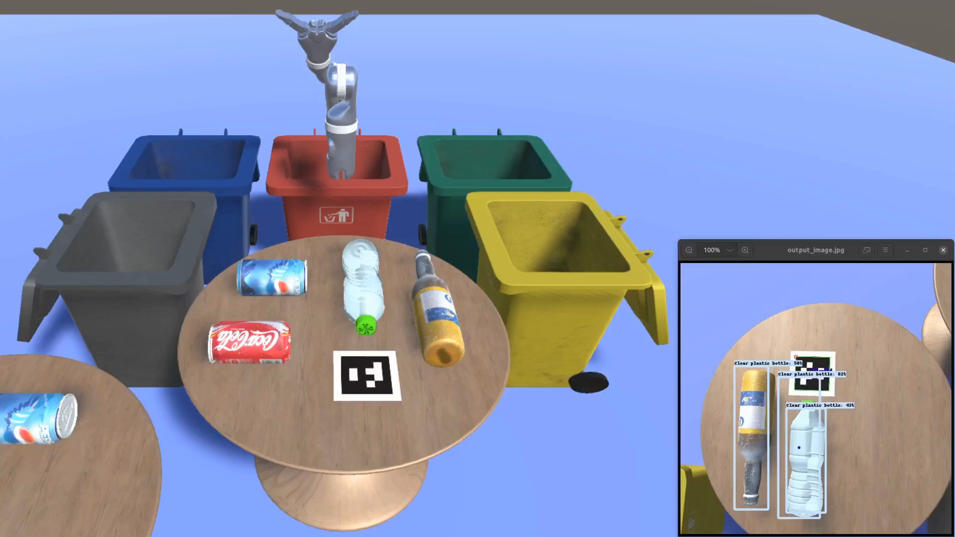
Demo Video

Slide 9
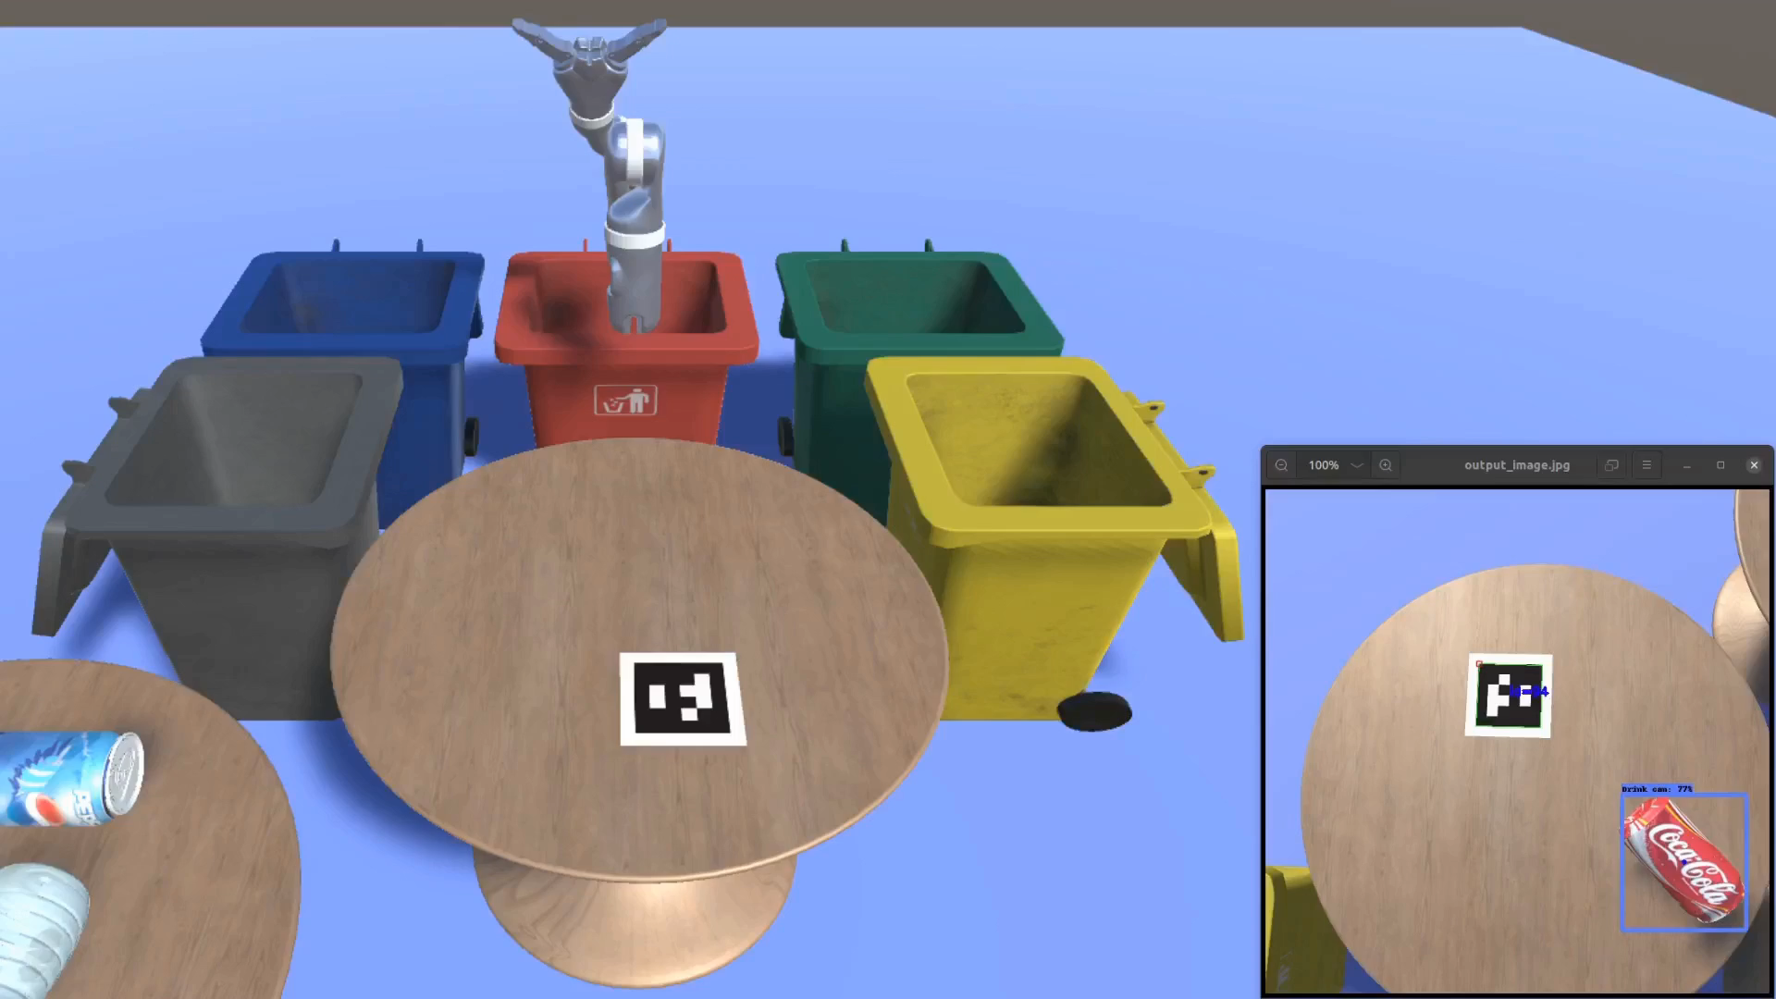
Real-time Application

Slide 10
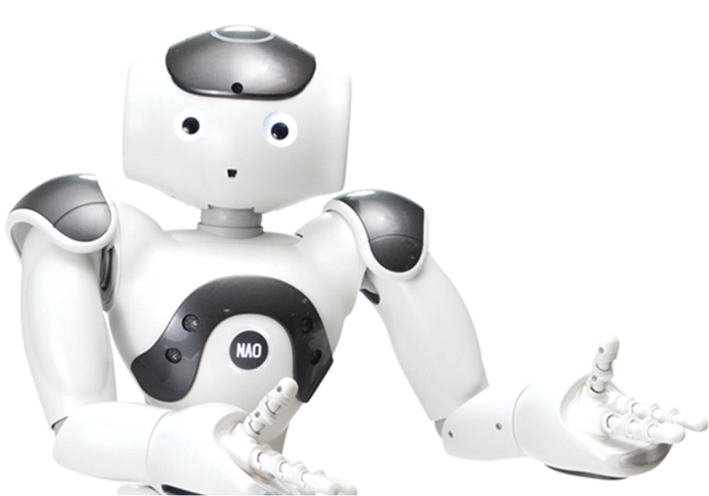
THANK YOU!

